Slide 1
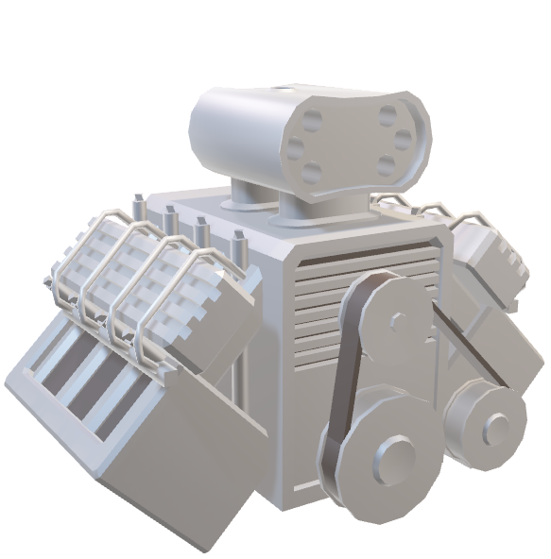
Unity: The Basics

Slide 2
What’s the point?
Unity is a game engine that abstract away most of the difficult, repetitive, or tedious parts of game development that have to be done to get the magic on screen to happen, but that we don’t really want to do ourselves.
Engines provide the basic tools and methods for getting things done “behind the scenes” that allow you to not worry about OS or Harware type, the specifics of collision physics or light.

Slide 3
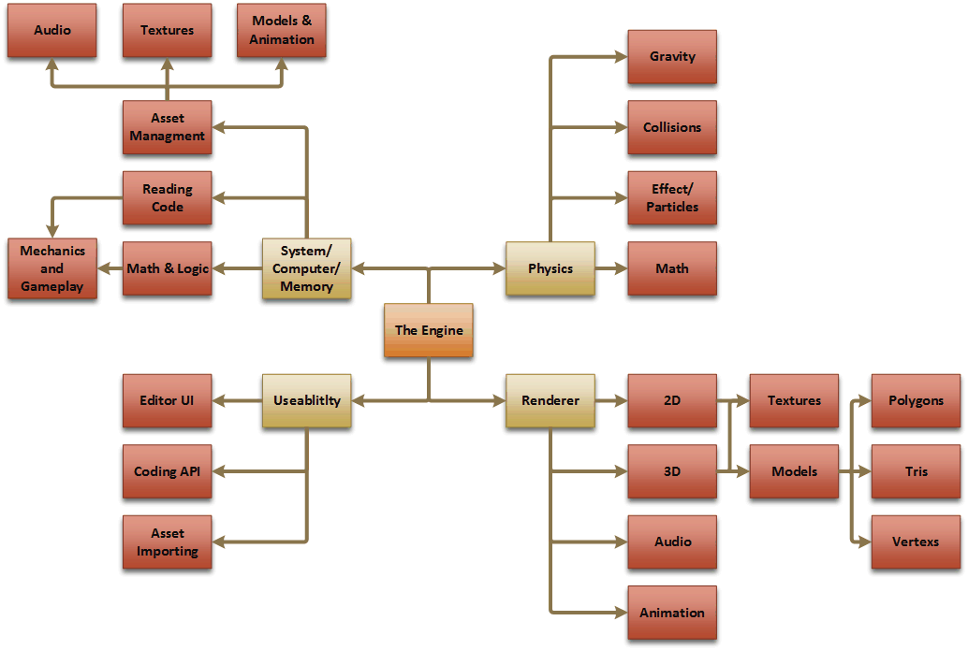
What an Engine does
You don’t care about almost any of this. If you do you can modify much of it yourself if you want or need to.
Basically instead of calculating a rotation matrix or Quaternion for your turret and lerping it manually you can instead essentially say “turn to point at this location”.
Side note: THE API DOCS ARE YOUR NEW BIBLE! You can’t be expected to know all of the functionalities at your fingertips and the proper ways to use them. Don’t be afraid of looking it up in the docs.

Slide 4
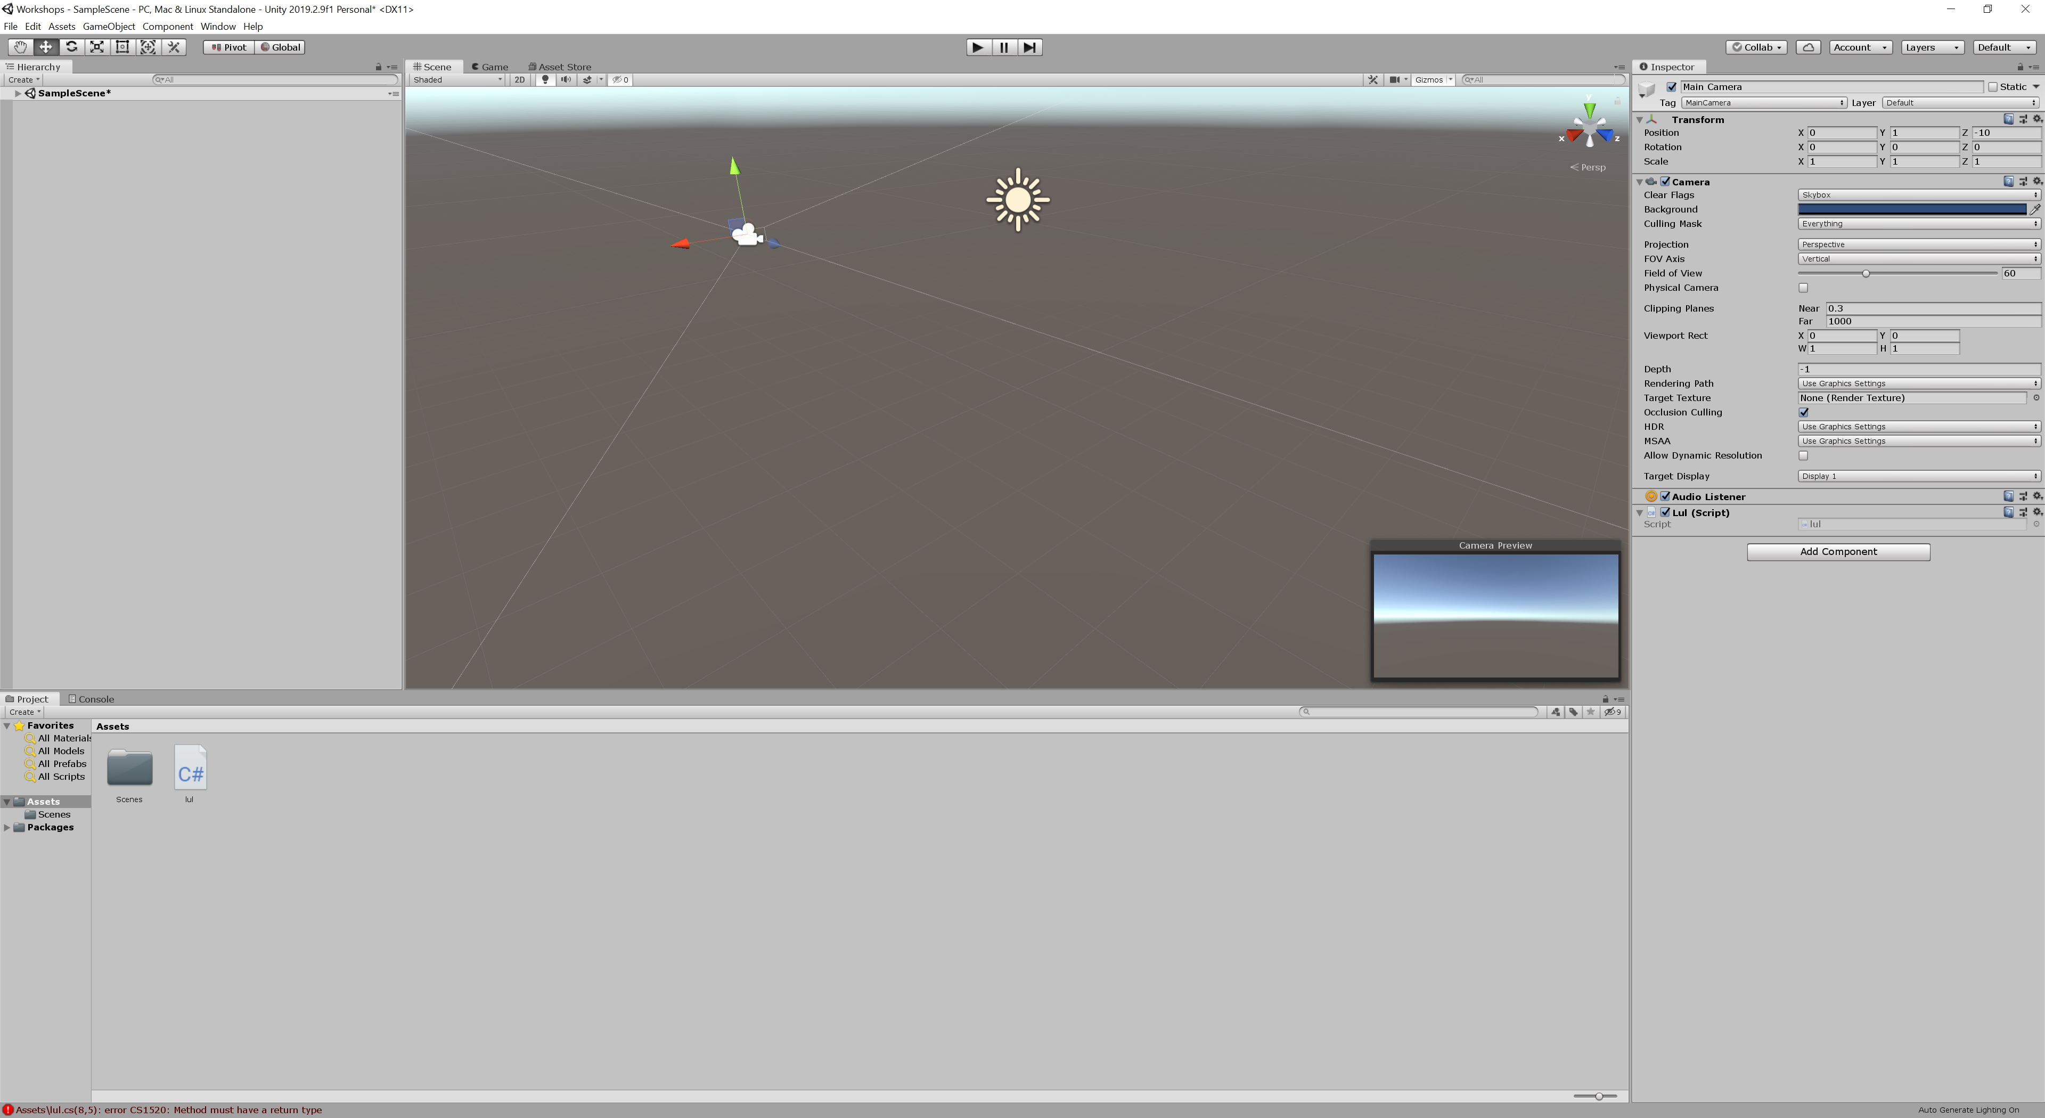
The Default Layout

Slide 5
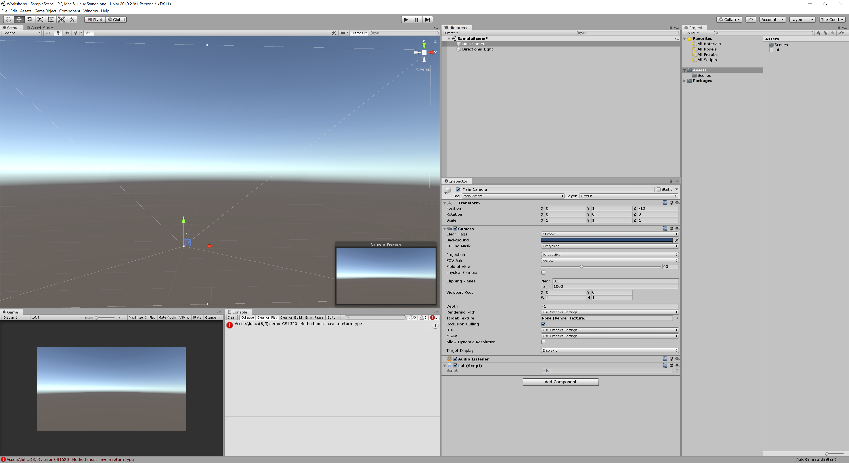
My Preferred Layout
Same windows, different place to find them. Option to change in top right.

Slide 6
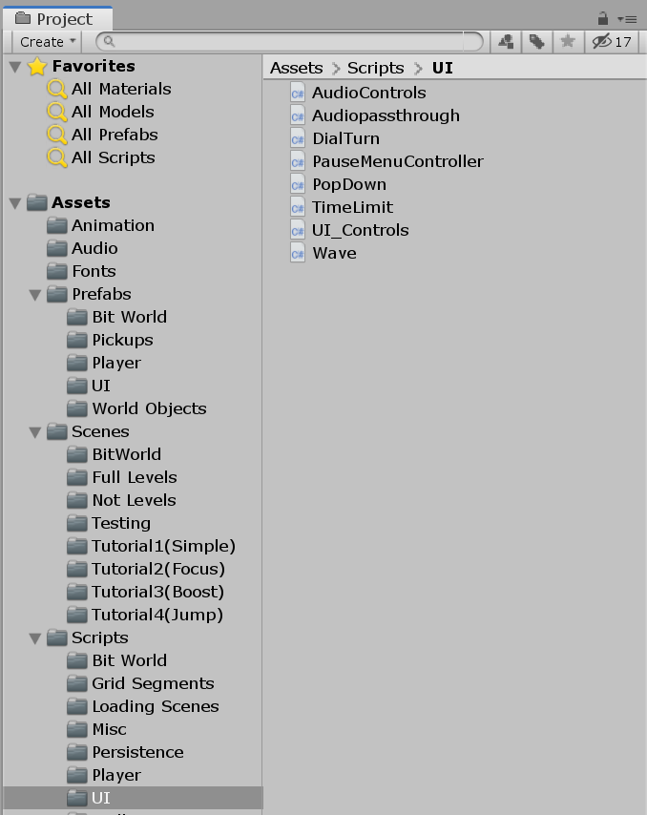
The Project Tab
The Project tab is a structured tree representation of your project folders and files.
It is imperative that you keep this well managed and organised form the beginning. It can grow in size quickly.
This is the folder structure for a jam game I helped make in 2017.
When you start any project make sure you have folders for: Prefabs, Scripts, Graphics, Scenes, or some variation of this to suit your expected needs.

Slide 7
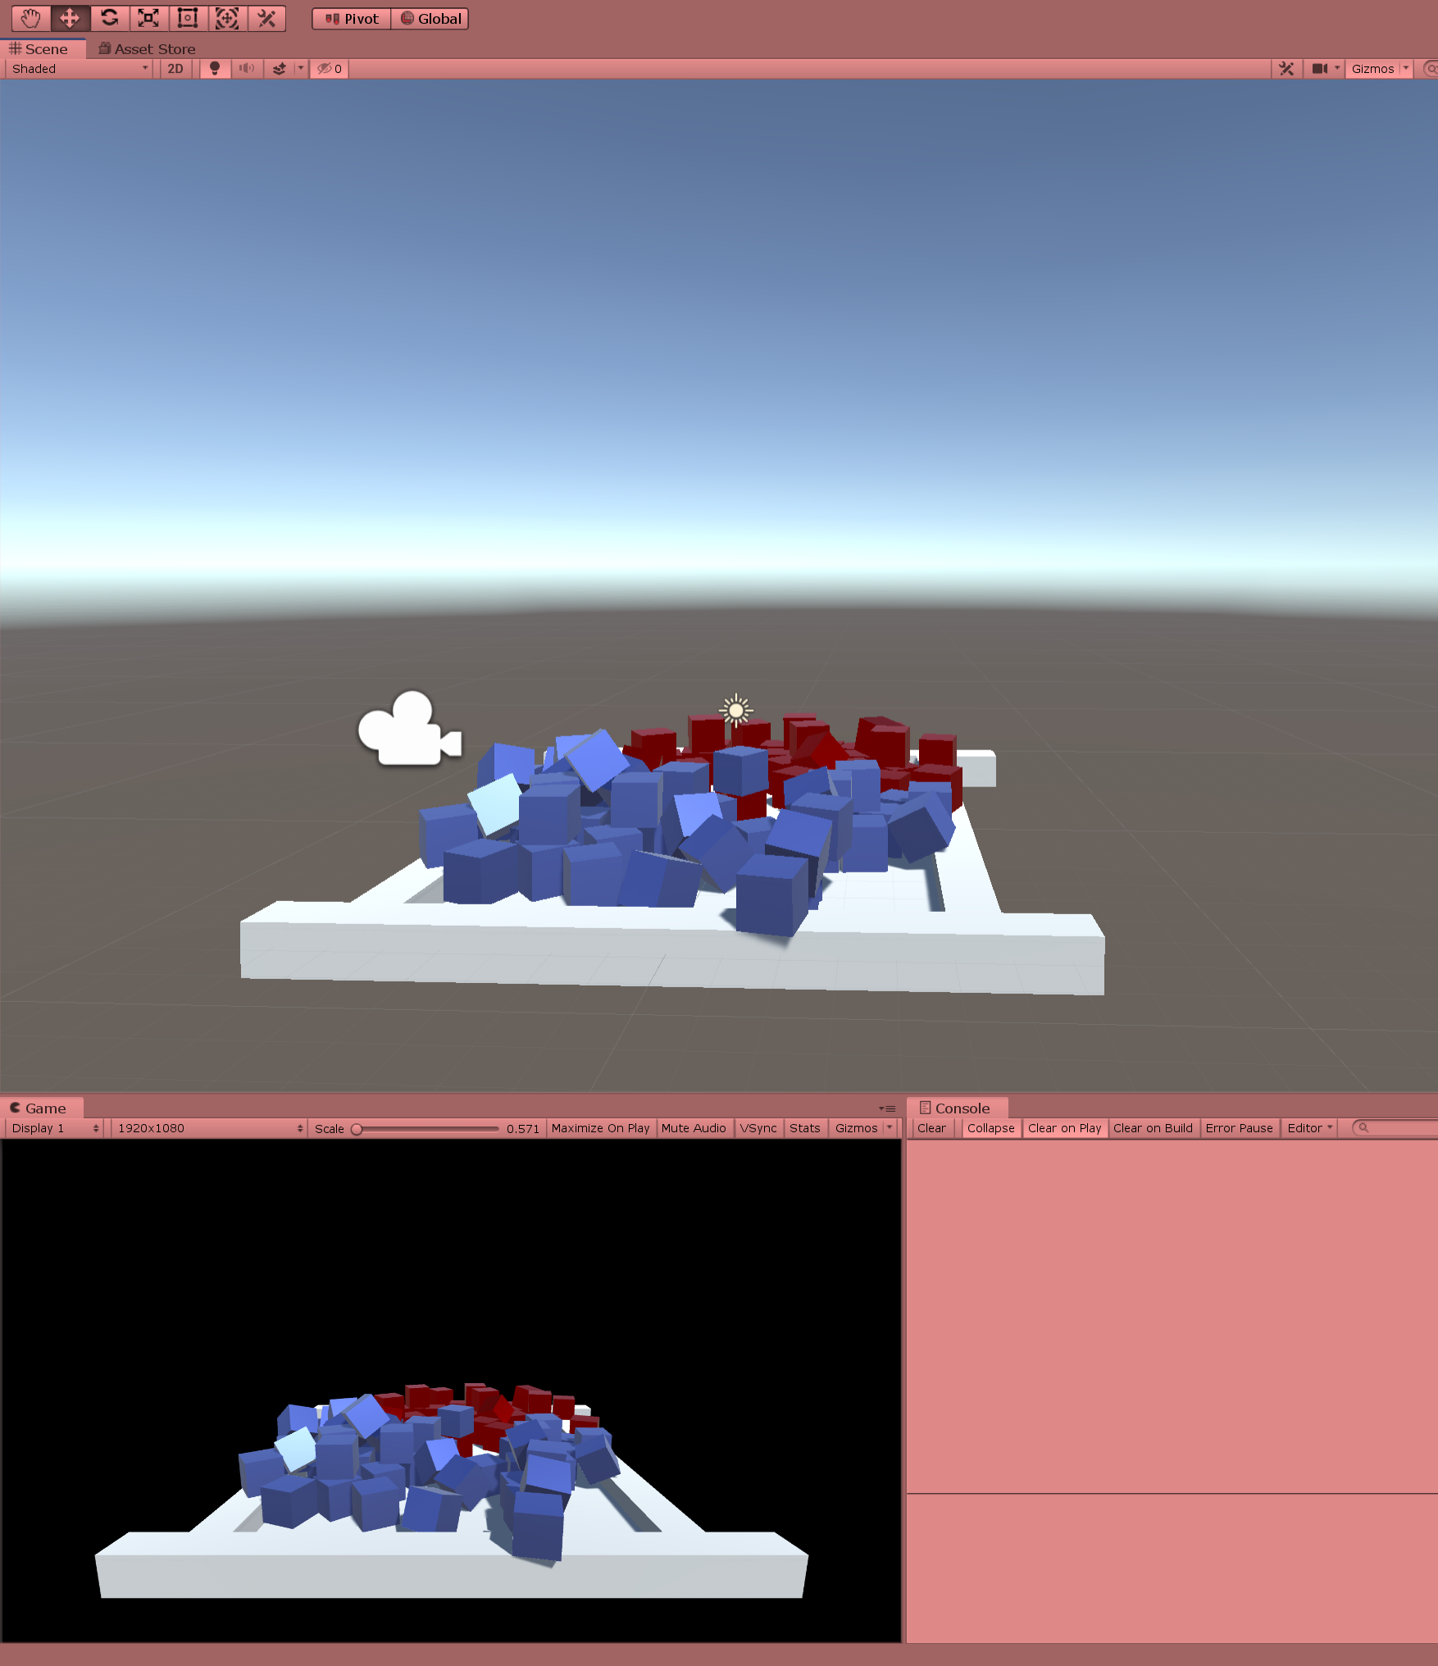
Game Tab vs Scene Tab
Scene tab: A free look camera where you can selecte and manipulate objects in the current scene.
Game: a view of what a player would see through the game camera.
In this shot you can also see the debug console. Where errors, warnings and endless debug print statements will be logged.

Slide 8


Play Mode
In play mode the game plays out as though it would for a real player. You can interact with the game via the Game tab.
In this mode any changes made will be reverted back to the way they were before you entered play mode. For this reason I configure my editor to turn red to remind me when I am in this mode. I will demonstrate this now.
The game may be “paused” by clicking the pause button.
The final button can be used to step through the program frame by frame.

Slide 9
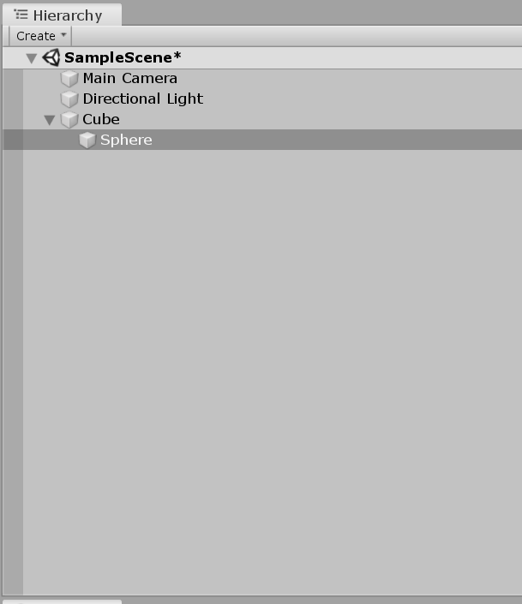
The Hierarchy
The Hierarchy shows all the game objects currently in the scene.
Objects which are children of other objects inherit the Transform (position/rotation/scale, this will be covered momentarily) of their parent but maintain their on local Transform as well.
You may select objects for manipulation here as it’s easier to navigate than a cluttered scene view and not all objects may be visible at time of editing.

Slide 10
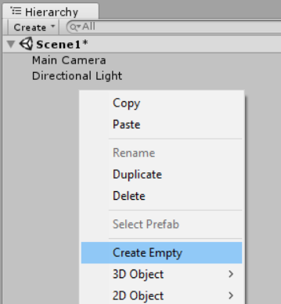
Adding Objects
Right click in the hierarchy and you can click, Create empty (for an object with no components) or pick from a selection of basic 2D and 3D shapes.
You may want an invisible object to act as the parent for a group of objects to be controlled as one.

Slide 11
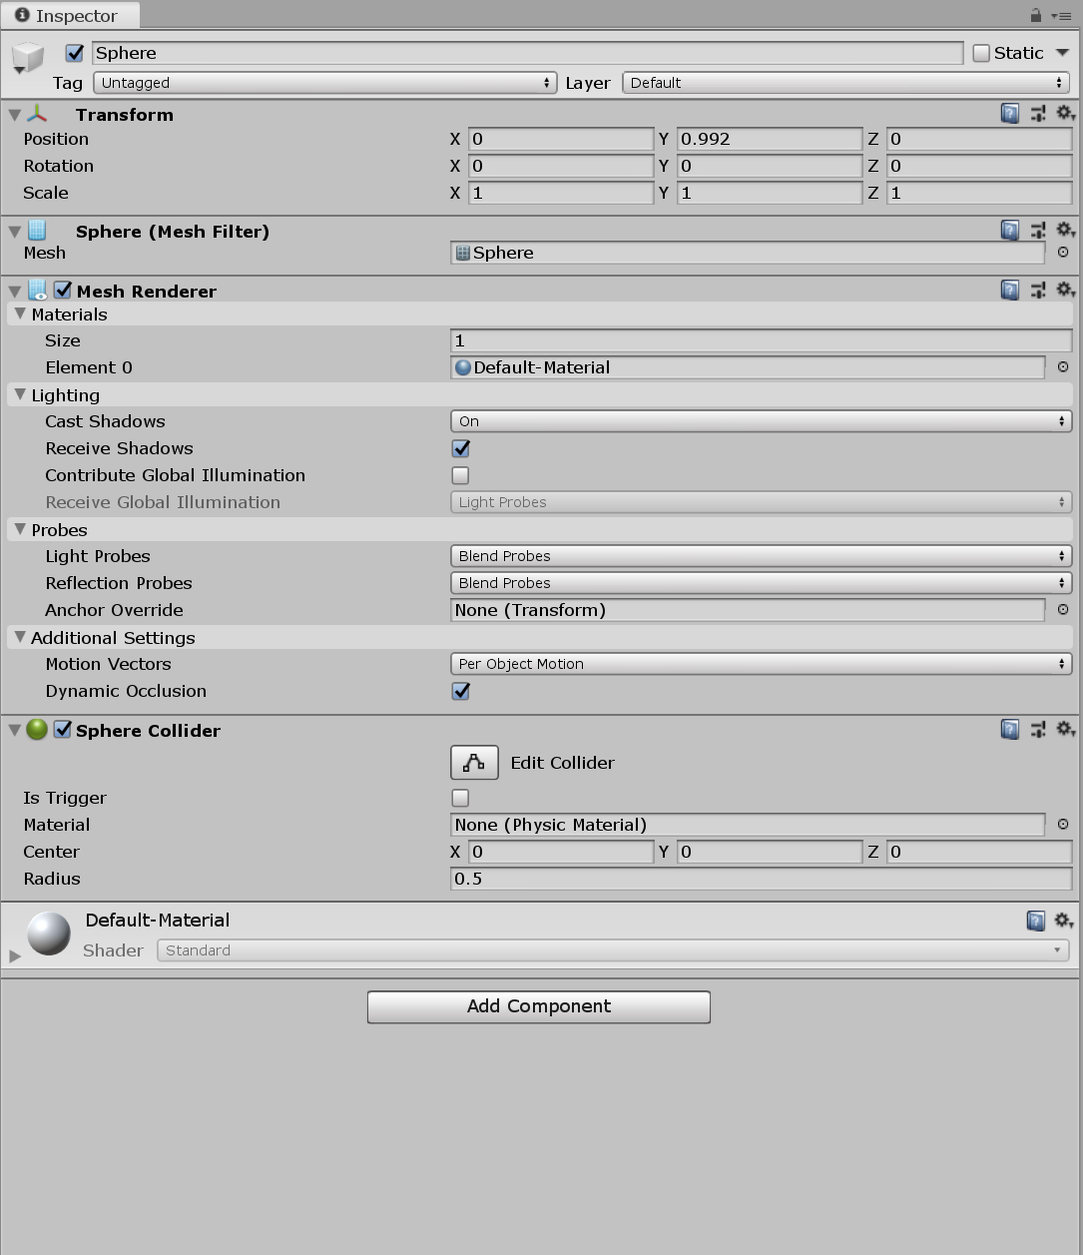
The Inspector
This shows all of the Components on a selected GameObject as well as the parameters of said components.
From the inspector you can monitor changing values as the game plays or edit them directly.
REMEMBER! Any changes you make using the inspector while in play mode will be deleted. You don’t want to lose a half hour’s work by accident.

Slide 12
Gizmos
At the top of the editor are a series of buttons for selecting what type of controls you want to use while editing objects in the Scene tab. I shall demonstrate but lets run over them.
The first is boring. It simple moves the camera around.
The second is the mover tool. This allows you to move objects on the X, Y and Z axes.
Third is the rotate tool. Much like the move too but, you guessed it, for rotations.
Fourth is the scale tool. You may scale either on all axes or only specific ones.
Fifth is the Rect tool. Click and drag stuff to the right shape.
Sixth is a combo tool. Fairly new it allows you to scale, rotate or move without switching modes but adds more screen clutter.
Last one is for custom editor stuff. Irrelevant for us.

Slide 13
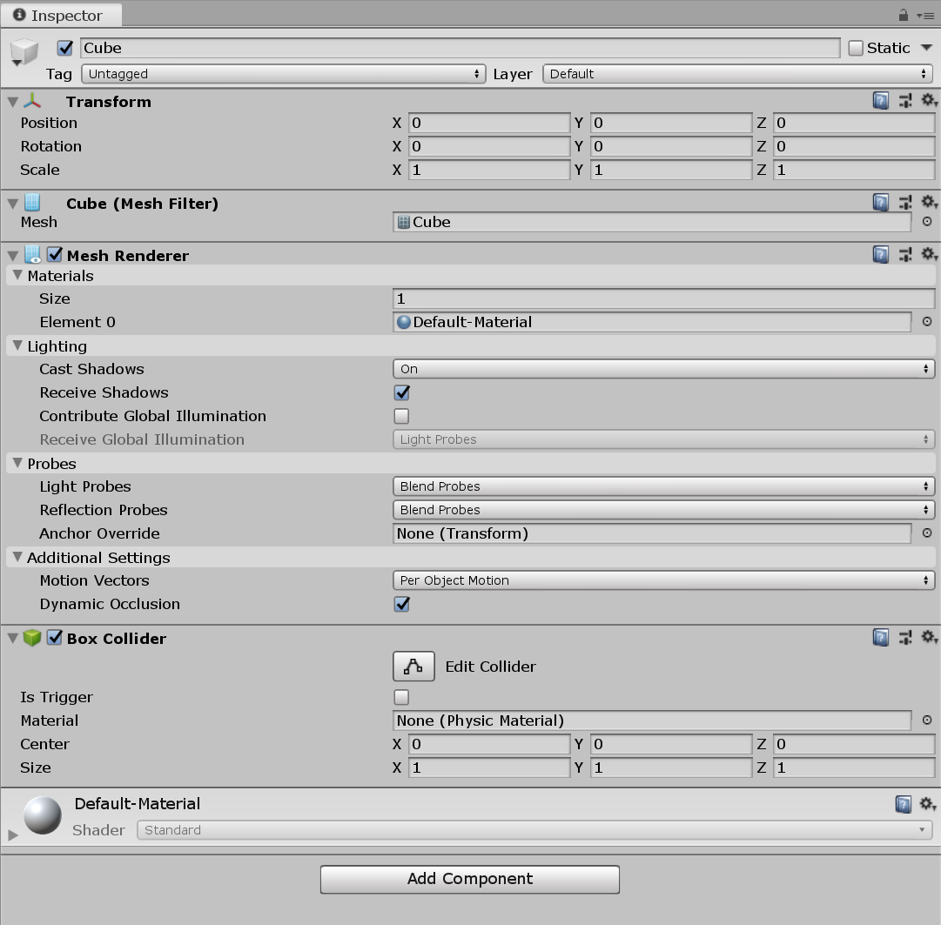
Components
Our simple cube has a few Components on it:
Transform – The location information for the object
Mesh Filter – The model the object is using
Box Collider – A box shape which unity uses to handle collisions automatically
Mesh Renderer – Details about how the game looks at the model and shows it to us
Material – The material applied to the model (we’ll go into more detail about materials later)

Slide 14
Adding functionality
If you want to give an object more abilities you have to give it the necessary components.
Right now if you press play the cube will do nothing. Lets add some physics.
Click the button labelled “Add Component” and either navigate the dropdowns vie Physics -> Rigidbody and click Rigidbody, or type “Rigidbody” in the search field and click the result.
Press play.

Slide 15
Prefabs
Prefabs are “Pre-fabricated” GameObjects with all of the components and parameters combined and saved. They allow us to bring into the scene replicas of a known object at any time via code, or copy easily and accurately a reused object between scenes.
Save the cube as a prefab by clicking on it in the hierarchy and dragging it into the project tab.
If you haven’t already, make a Prefabs folder and place it inside.
In newer versions of unity you can nest prefabs or make variants that inherit from a base prefab. We will look at this next.

Slide 16
Materials
Lets make some materials and some different prefabs with varying materials on them.
Make copies of your prefab in your scene and drag the materials you want onto each individual.
Renaming and dragging these individuals back to the project tab will now allow you to create variants of the same prefab.
If you change non-overridden values on the base prefab it will change for all derived prefabs. This allows you for example to have multiple ememies that perhaps look the same but move differently or are colour coded differently.

Slide 17
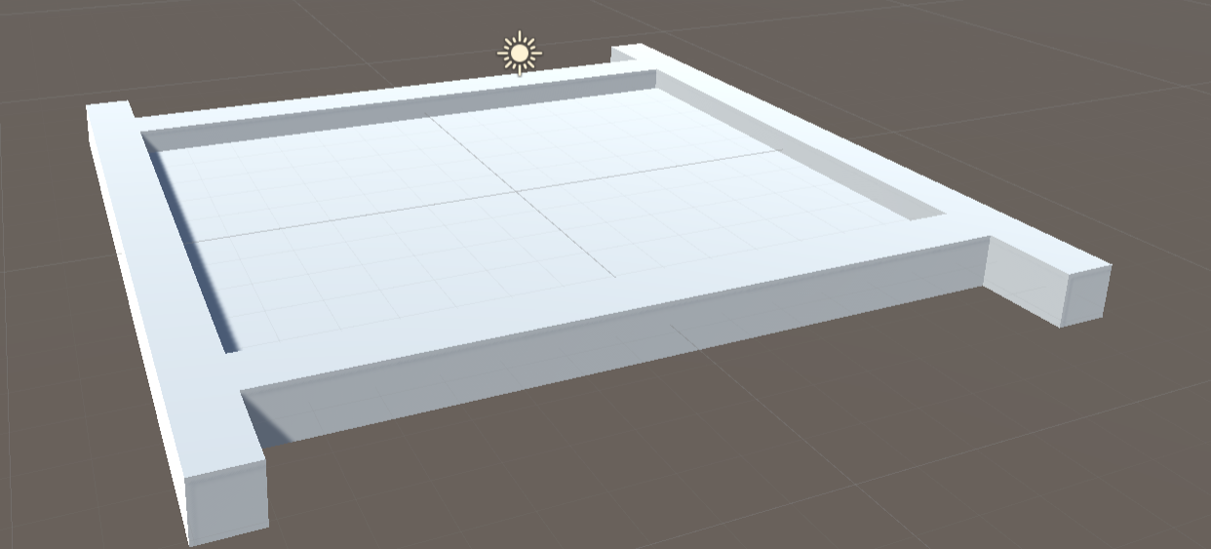
Something to Collide with
Using what you know of the Scene Tab, Hierarchy, and inspector make a platform out of stretched cubes for your physics cube to interact with.
Recommend creating an empty object and making up the platform or arena from a collection of modified cubes grouped under it.
Rename objects with a click and hold in the Hierarchy to keep things organised.

Slide 18

C# Code
Lets Make something happen.

Slide 19
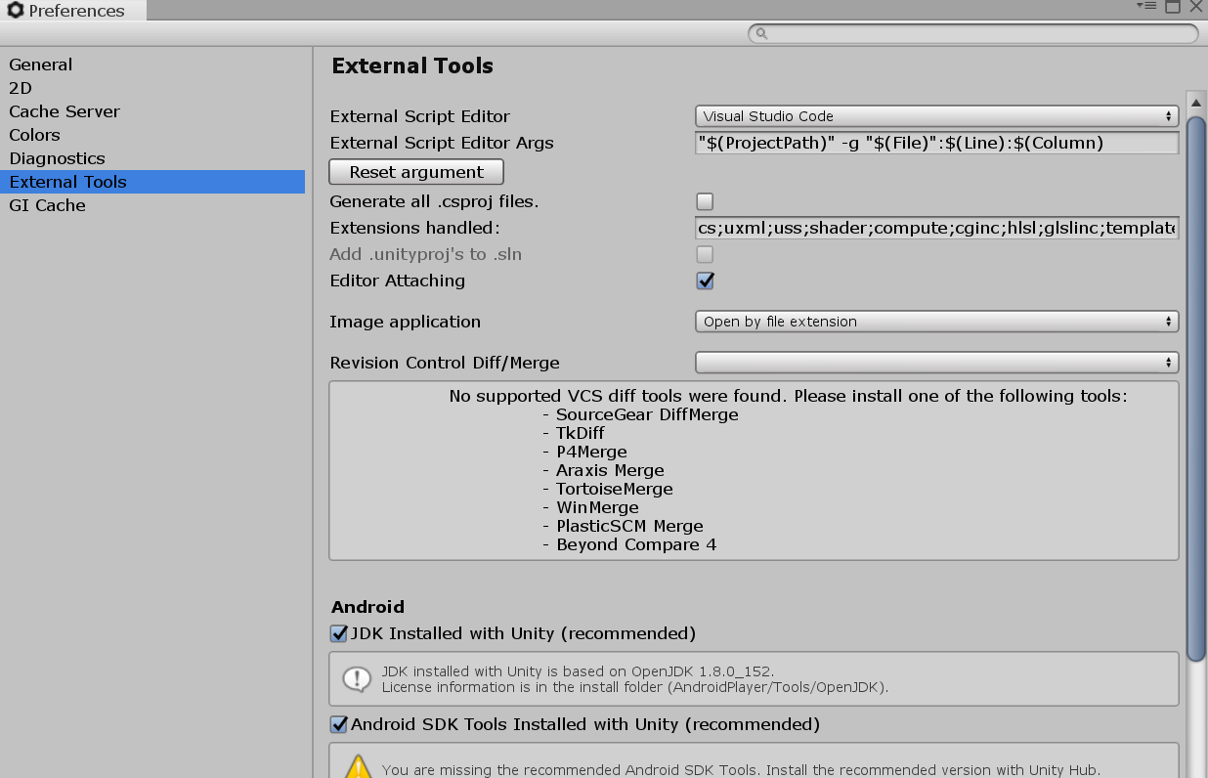
Code Editor Setup
Lets make sure we all have the same environment so that I can easily help you out and you can help each other out.
Go to Edit -> Preferences -> External Tools and make sure it’s set to Visual Studio Code.
To add code right click in the project tab ans select Create -> C# Script. Give it a name.
Double click it.
Once VS Code is open you’re going to need a couple packages. Go to the extensions tab and install the C#, Unity Tools, and Debugger for Unity packages.
We’re ready to go.

Slide 20
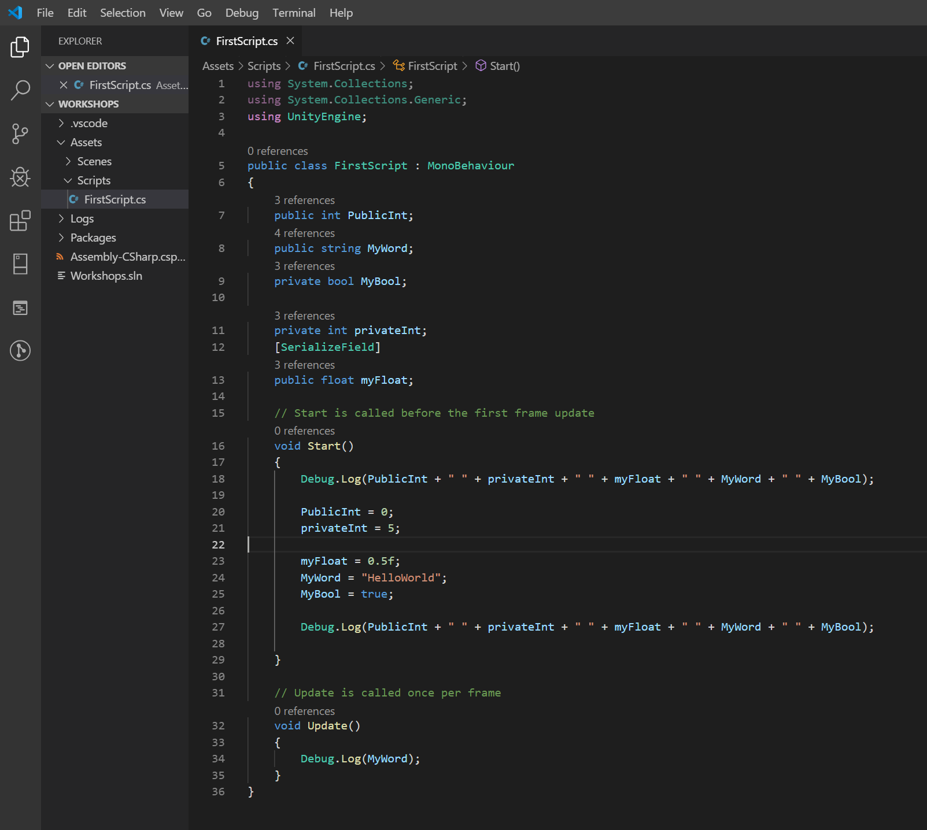
The Fundamentals
You guys know the drill. You’ve all at least done Java. C# is very similar. You will notice some syntactical differences.
I will focus on Unity API specifics here.
Brief house keeping:
Convention in C# is camelCase for private, PascalCase for public.
bool instead of Boolean like C instead of like Java
Lower case s for string
Unity stuff:
Public attributes are editable in the unity editor.
Private attributes may be made editable in the editor by placing [SerializeField] before it on the same line or above. Access control is maintained.
Debug.Log() is equivalent to a print(), println() or console.log
Start is called when the gameObject the script is attached to has loaded.
Update is called every frame.
The Monobehaviour class which is inherited means that this class is intended to be used on a GameObject that exists in the scene and not as general code.

Slide 21
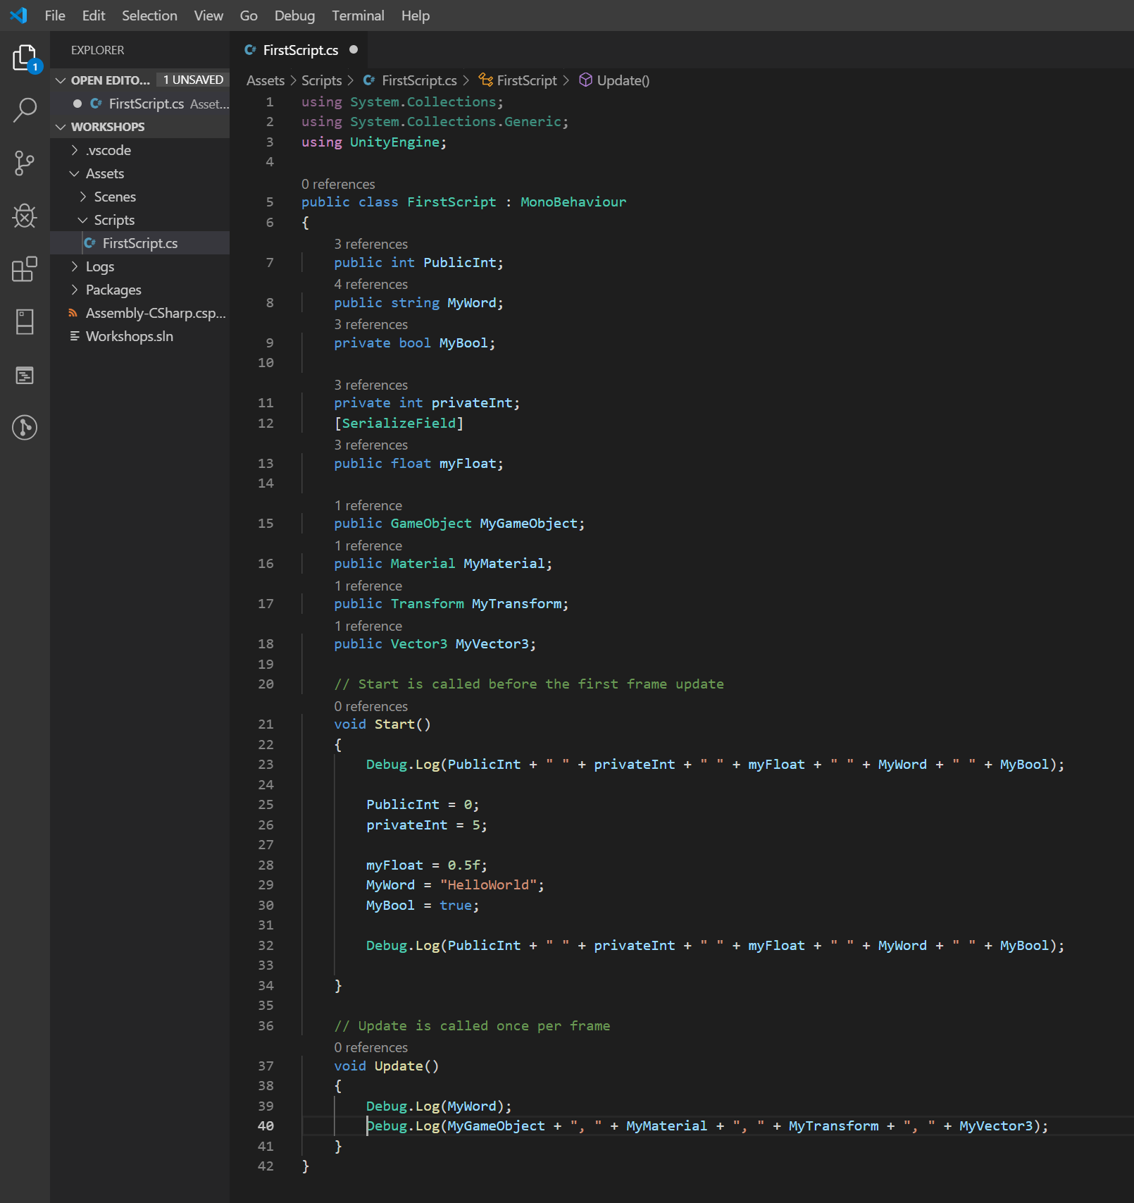
Unity DataTypes
GameObject: A reference to an object in the world or prefab in the project.
Material: A reference to any material in the project.
Transform: The position Rotation and scale of an object.
Vector3: 3 floats generally used to denote XYZ coordinates or directions.
Additional common data types:
Quaternion: a representation of rotation
Components: any component type can be referenced by it’s name e.g. Rigidbody/RigidBody2D.

Slide 22
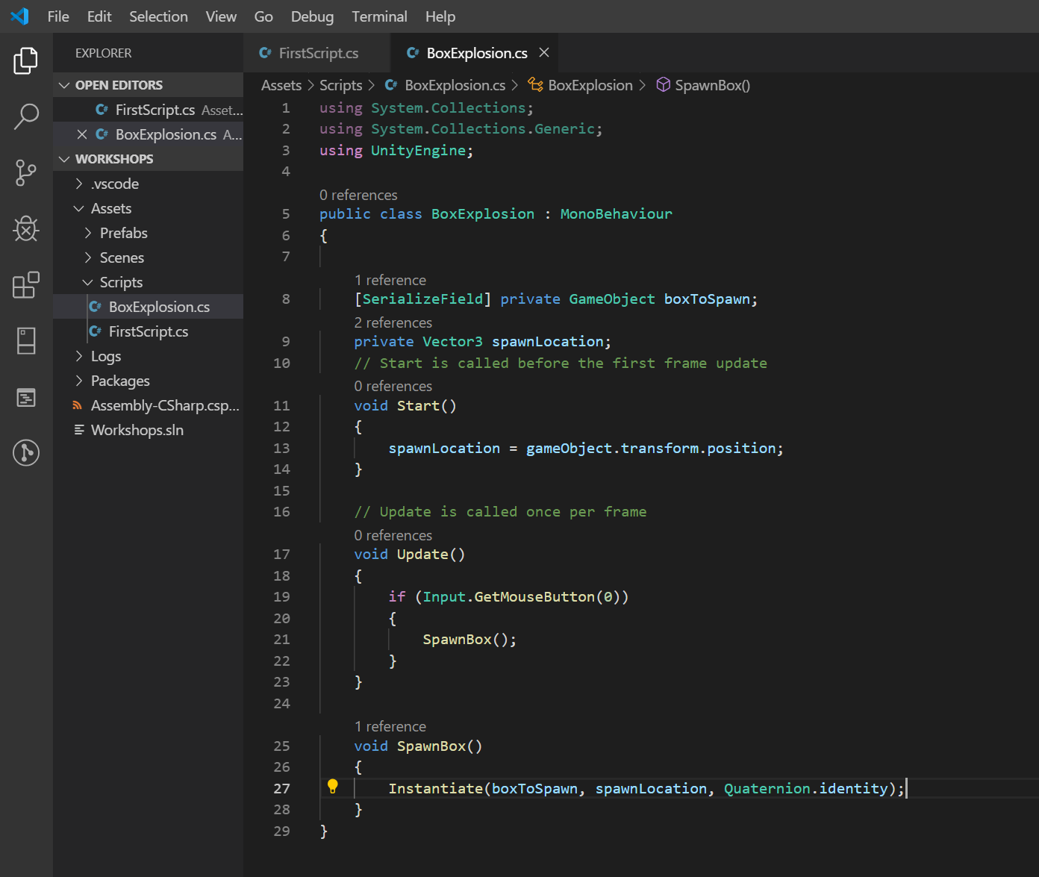
Spawning stuff
We’re going to do some crude reaction to user input now.
Input.GetMouseButton(0) returns true if the left mouse button is currently held. If you prefer to trigger only once it’s a simple as changing to Input.GetMouseButtonDown(0).
Inside Start we set the variable for where we want to spawn a box equal to the current GameObject’s transform.position. Upper case GameObject is the clss name for game objects whereas lower case gameObject always refers to the current gameObject this class is attached to.
Instantiate places a new instance of an object into the scene. First parameter is the object itself, second is the position as a Vector3 and third is a rotation as a Quaternion.
Quaternion.identity is a rotation equivalent to an identity matrix, that is to say zero rotation. It’s simply the default rotation of the object.
That’s a lot to achieve in very few line of code.

Slide 23
Timers and clocks
There are several schools of thought on timers. I will show you 3 common ways to cause recurring actions on timers and their differences.
Method 1/1.5: Invoke (“MethodName”, timeInSeconds) – Pass the name of the method you want to trigger and the time delay. This can also be done recursively.
Method 2: Add Time.deltaTime (that’s the time between frames) to an accumulator and fire the event when you get to the number of seconds you want. Remember to reset accumulator to zero if you want it to repeat.
Method 3: Subtract current time from the start time and if the answer is larger than or equal to your wait time then fire the event.

Slide 24
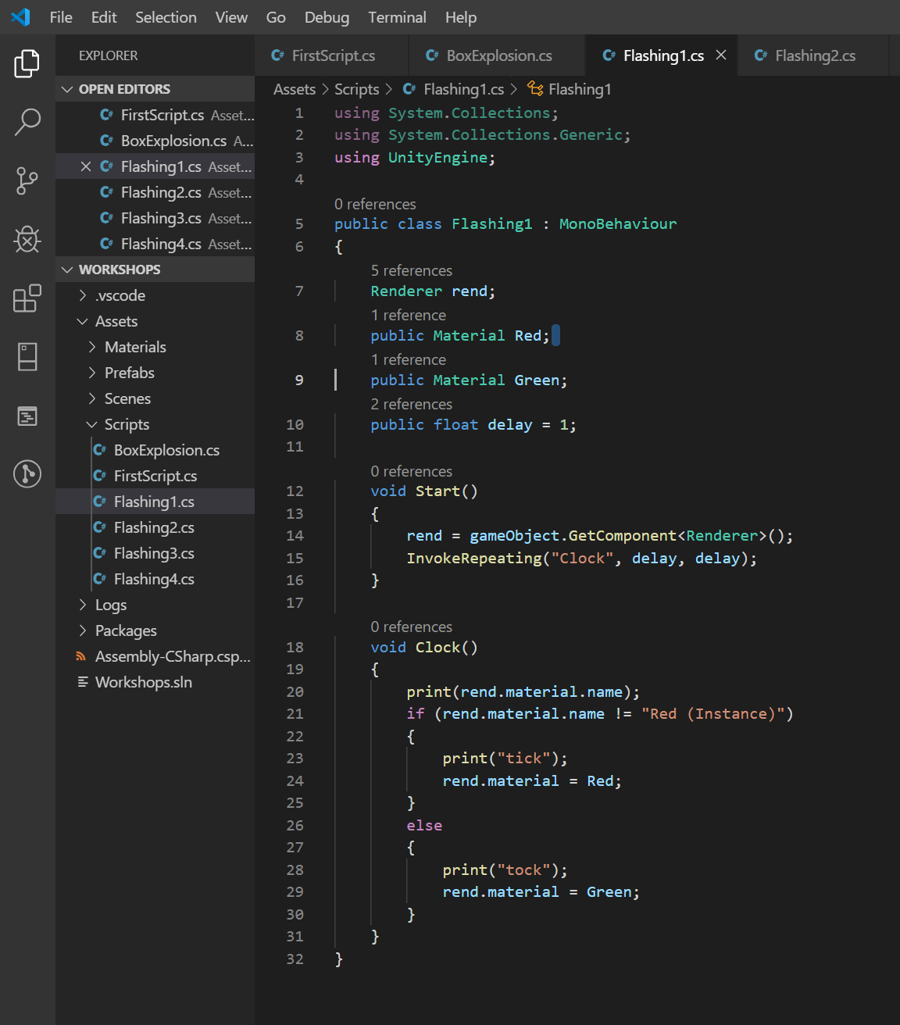
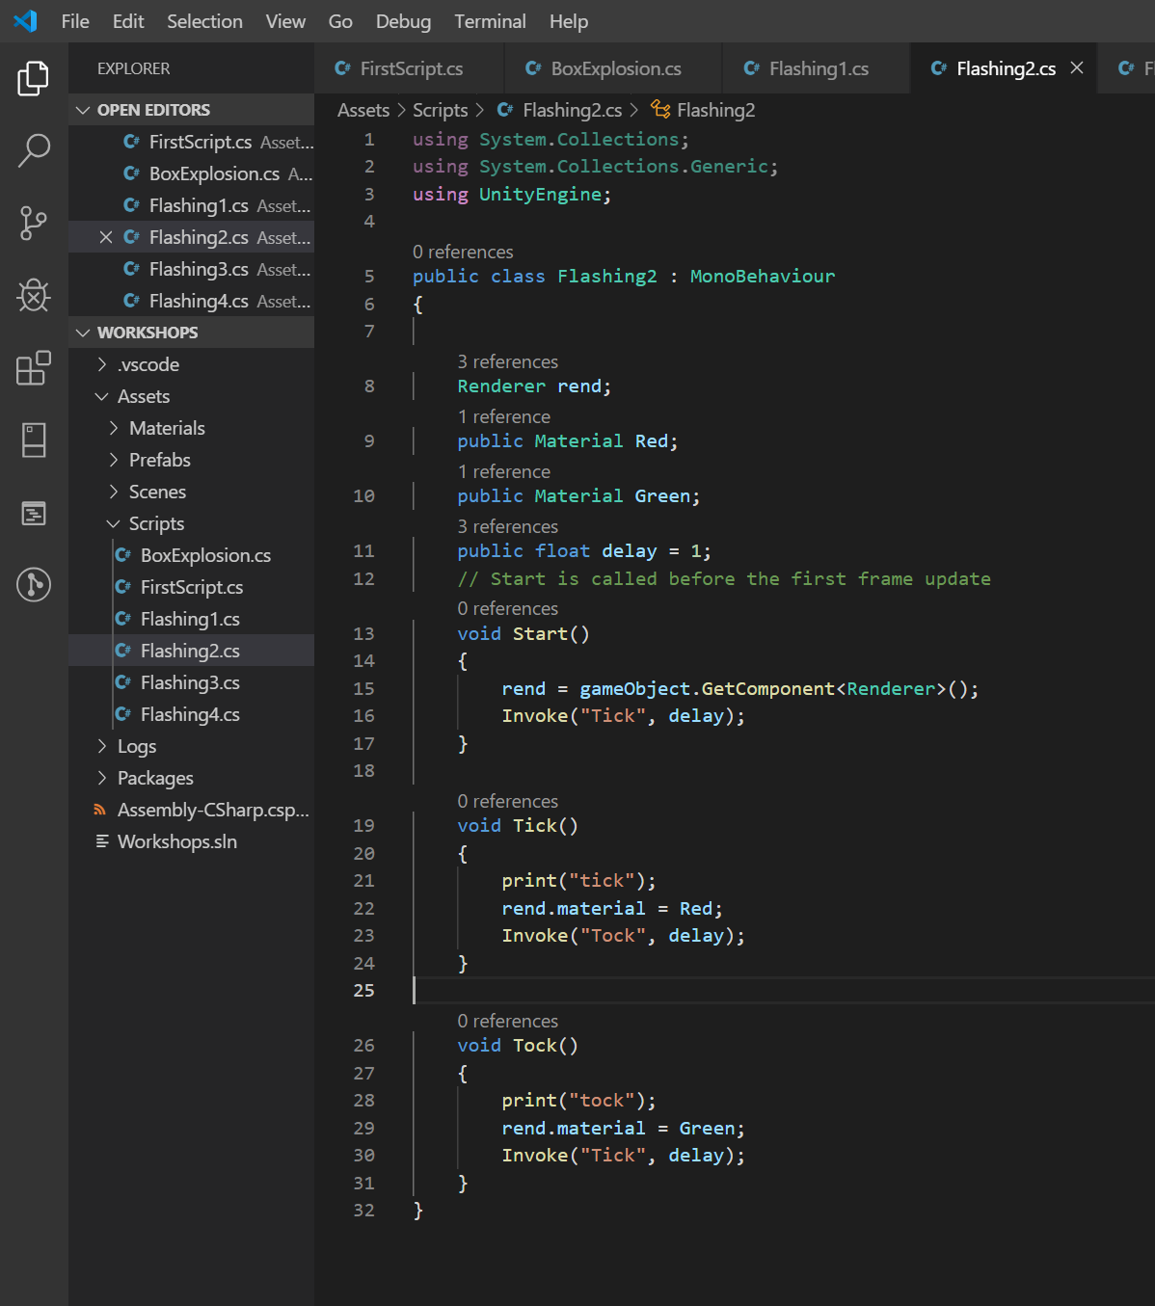
Invoke
Pro - Doesn’t have to wait for the frame update to fire. Closer to realtime.
Con – doesn’t scale for frame rate. If you have a lag spike the timer will keep going like you hadn’t lost any game time when you actually have.

Slide 25
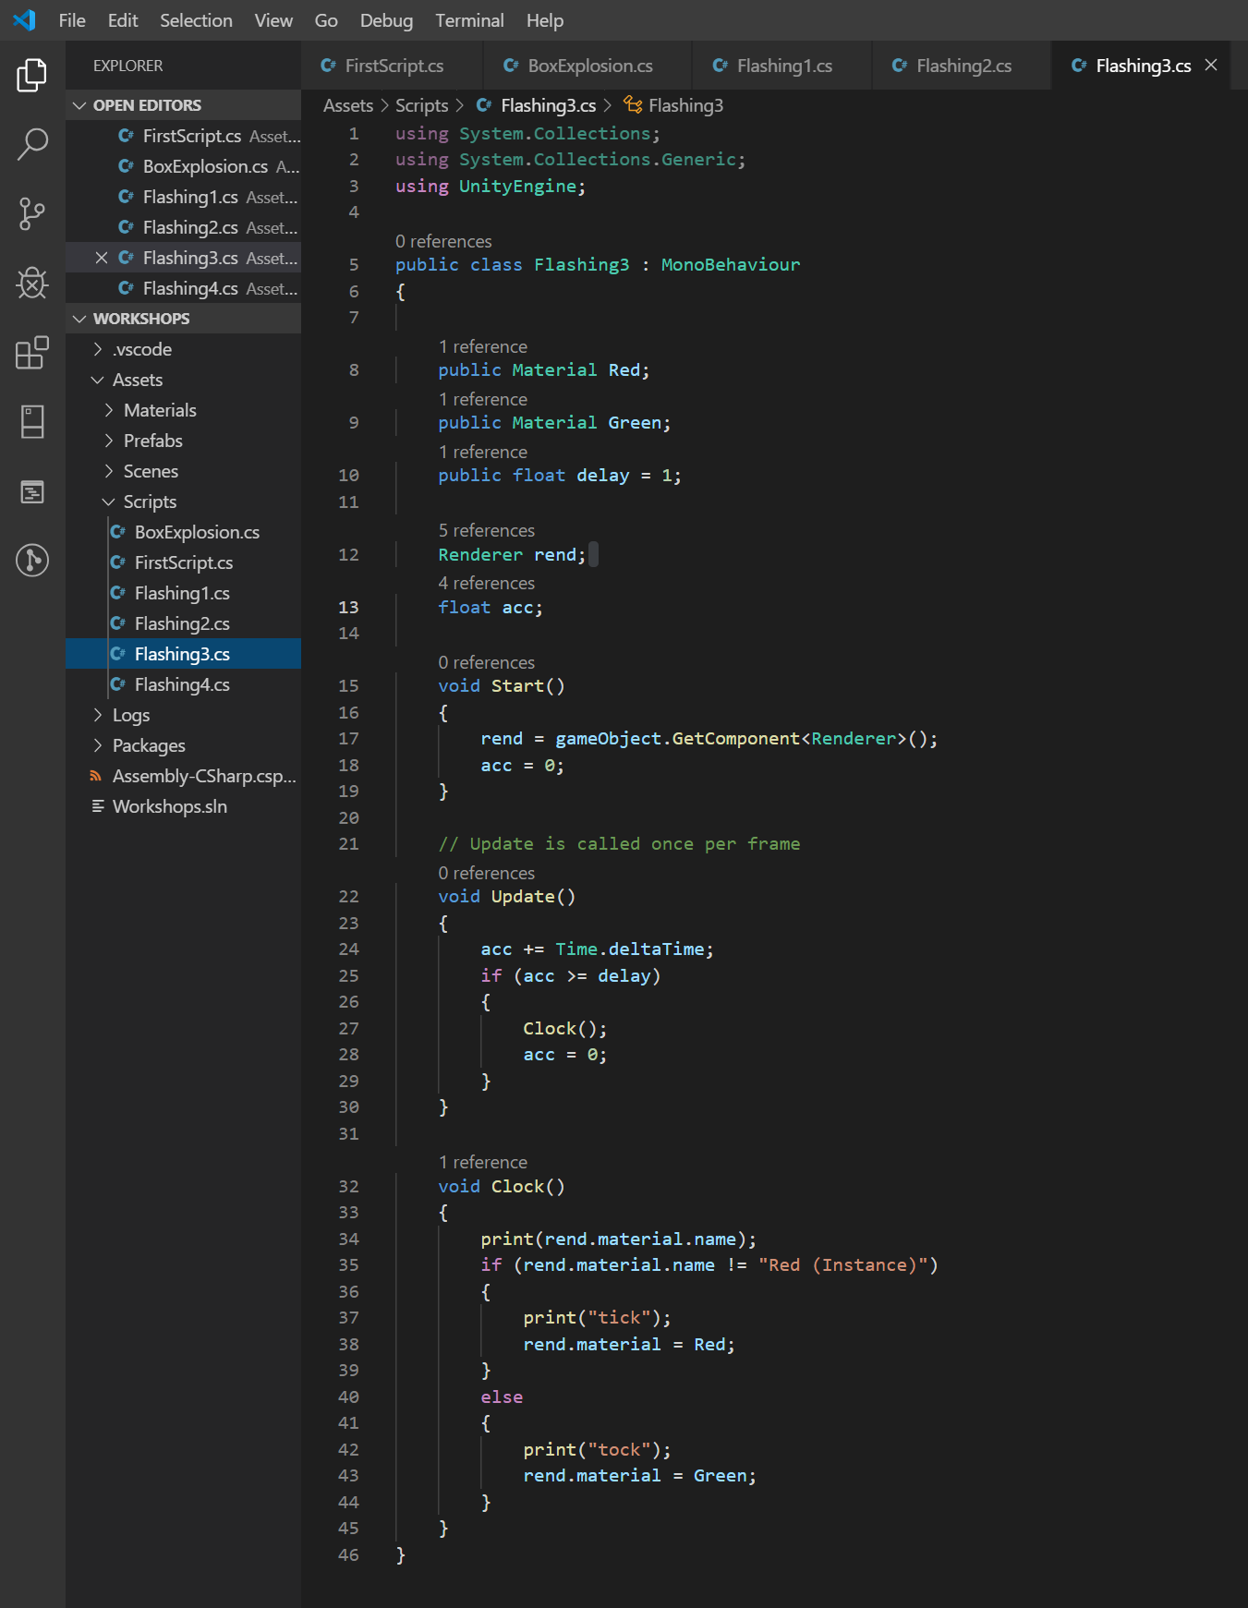
Accumulator
Less perfectly accurate thanks to having to wait for the previous frame to render before checking. Perfectly adequate for game logic.
Preferable for countdowns rather than constant pulse clocks.

Slide 26
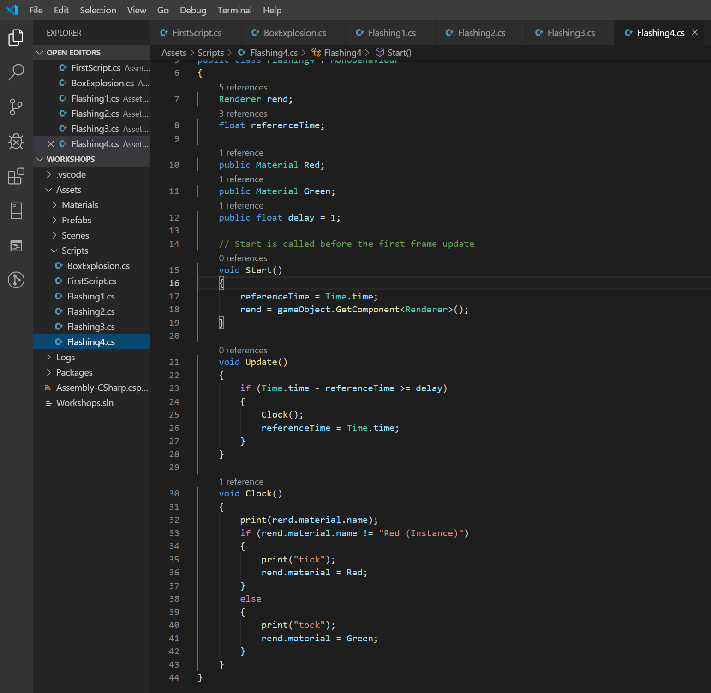
Time Comparison
Similar issues to accumulator. Lacks the benefit of keeping a running track of the time left.

Slide 27
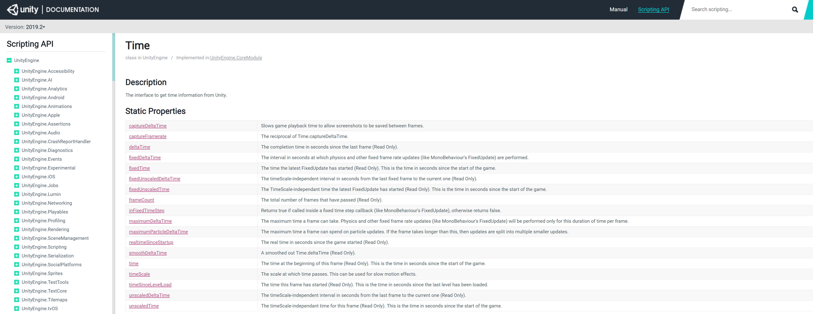
USE the API Reference docs
There are a huge number of ways to access time, each a little different.
Look at the API reference for the Time class and choose what suits your usecase.

Slide 28
3D player controls
2D is very similar, if a bit simpler but we’ll cover that too.
Create an empty object with a Rigidbody component and a Capsule Collider component.
Add a script called PlayerController or whatever you prefer to call it.
I’ll take you through how to do it but I would like to take some Ideas on how we might do
Keyboard/mouse input
Get a reference to our camera
Apply movements
Calculate rotations

Slide 29
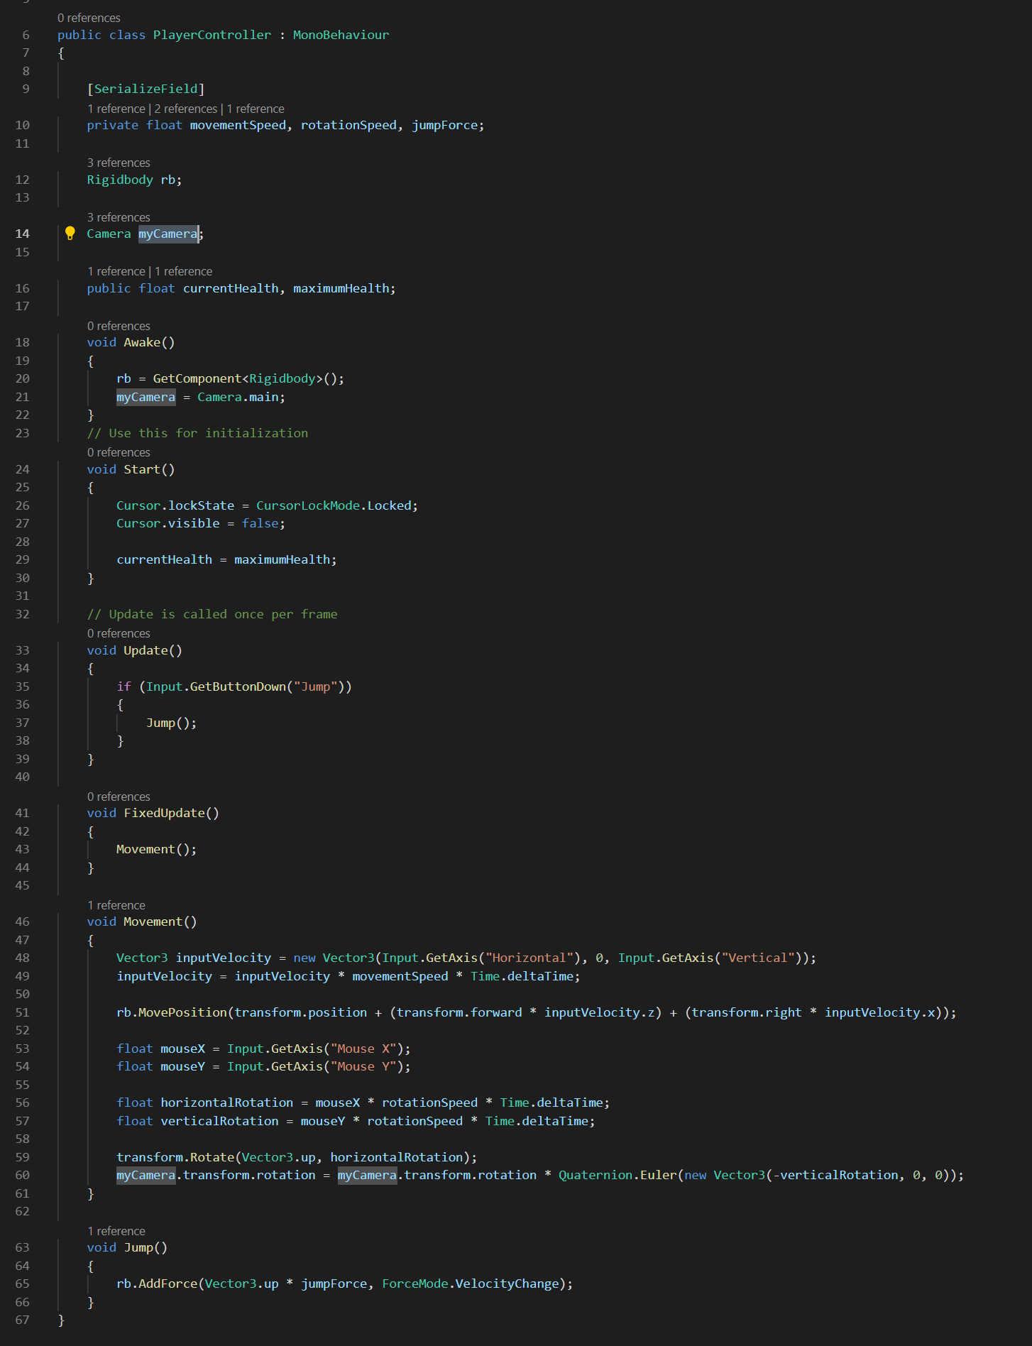
Basic controller
This is what our minimum functionality looks like.
Can you predict any problems we might have as a result of this implementation?

Slide 30
Chain Jumping
We need a test for whether or not our character is on the ground or not. If we have time I will dip into it now.
If not we will go into proper detail on it next week as it uses a component who’s functions we’ve glossed over a bit – the collider.
More info and uses for the colliders will be explained next time.

Slide 31
Upcoming Sessions
Collision events
Getting Components or data on other objects
Raycasts
Design Patterns
Asset import
UI
Save data
How to build to standalone app or web
Animation controls
Multiplayer would be nice but we don’t have the time

Slide 32
Contacts
Daniel “Dan” Korsah : 40214314@live.napier.ac.uk
Krzysztof “Kris” Czerwinski : 40283208@live.napier.ac.uk
Complaints to Thomas “Tom” Methven : T.Methven@napier.ac.uk

